Slide 1
Career Development Strategies: CPID Overview

Slide 2
Activity
How did you get to where your at today?
On the sheets provided
Write a rough timeline of your career progression
Next write the reasons you took the job or entered training
Family influences, funding, career knowledge ect.

Slide 3
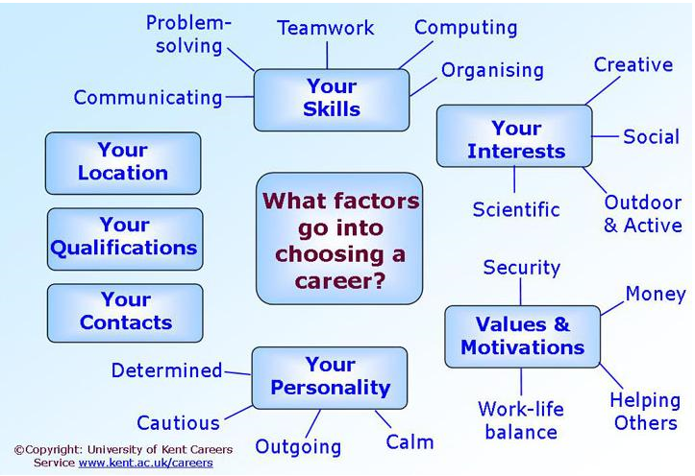

Slide 4
Fleming Video
https://www.youtube.com/watch?v=zs6nQpVI164

Slide 5
Choosing a career typically falls within 4 stages…
Self Awareness
Opportunity Awareness
Decision Making
Taking Action
Notes:
Self Awareness – looking at Skills, Values, Interests , Interest, personality –
Looking at your strengths and weaknesses
Important both in choosing the right career and also for success in applications and interviews where you will find many questions which test whether you have been through this process.
Opportunity Awareness
the next stage is to gather information on the opportunities open to you
Decision Making
Taking Action

Slide 6
So what are career pathways?
A combination of rigorous and high-quality education, training, and other services that
Meet an individual’s goals
Aligned with industries
Attain a recognized credential
Enable movement within an occupation
Notes:
Virginia has an overall State Career Pathways as well as our own separate CPID grant.
The state wide Virginia Career Pathways has been in existence for close to ten years,
CPID is aligned with this state group.
To define the goals of a career pathways we look at a
A combination of rigorous and high-quality education, training, and other services that
Meet an individual’s education and career goals;
Are aligned with the skill needs of industries in the State or regional economy;
Help the individual to attain a recognized secondary or postsecondary credential; and
Enable the individual to enter or advance within a specific occupation or occupational cluster.
Since I’m at heart a vocational Evaluator – I like to break things down. So I look at how to best explain a career pathway to a student/teacher/parent – So I use the example of Nursing…
This is a field that has a clearly defined outline. A student knows what credential/Liscense they need to move ahead. You start out as a nurses aide to CAN to LPN to RN etc. You know where you can go for school, for work and a good idea of pay.
Unfortunately most careers aren’t that clearly defined.
This is where the Career Pathways both our statewide and our CPID grant are trying to work out.

Slide 7
Virginia’s Approach
Two separate VR Agencies
Virginia Manufacturing Association
Powered through Partnerships/Co-Enrollments
System Alignments
Strategies for Counselors
Notes:
Going on to the next slide, The career Pathways for individuals with Disabilities grant was awarded in the fall of 2015. This federal grant was awarded to 4 different states. Today, I will discuss how Virginia’s approach is a bit different then other states that are receiving this grant.
So this grant is 5 years, a total of $4.3 million in Federal funds
Grant awarded to Virginia Departments for Aging and Rehabilitative Services (DARS) and for the Blind and Vision Impaired (DBVI). This is interesting to note because here in va our VR agencies are seperately Run. So this collaboration between sister agencies is pretty exciting. One of the positions that was created for this grant is for the DBVI side – Tish Harris.
Our grant decided to focus first on advanced manufacturing. So I will discuss how we are engaging employers, emphasizing co-enrollments, system Alignments and strategies to help VR counselors.
For Counselors:
George Washington University
Motivational Interviewing
Training with the Career Index Tool
Tours for Counselors and Partners

Slide 8
Advantages: Industry Focus
Virginia Manufacturers Association (VMA)
Nationally Recognized Certifications
Dream It. Do It.
Developing a tool to assess Lean and Assistive Technology
Second Industry Sector will be in Information Technology and implemented in the Northern Virginia Region in year 2.
Notes:
On this next slide –
CPID is labor market and industry driven.
Close to 234,000 people are employed in manufacturing in Virginia and that figure is expected to grow, especially with our aging population retiring. Most importantly these modern manufacturing jobs provide a living wage. In the Shenandoah Valley area the average manufacturing wage is $34,000.00 annually with an additional 40% in benefits.
We have partnered with the Virginia Manufacturers Association to work closely with employers. This is where my position has come in as the CPID VMA Liaison. My office is located at their headquarters and I work directly with VMA members. This has been invaluable. Not only have I been able to meet employers but I’m learning about the credentials needed for manufacturing, issues that manufacturers face, and what they need in their employees. I am also working with VMA to develop a tool to assess Lean manufacturing, universal design and assistive Technology within a manufacturing plant. With this we are working to show Virginia manufacturers how accessibility and accommodations benefit business.
VMA though their Manufacturing Skills Institute has developed certifications that are state and nationally recognized. CPID is especially interested in their Manufacturing Skills Certificate and Manufacturing Technician 1 certificate.
I have also learned more about VMA’s Dream it. Do it. An outreach created by manufacturers to address the interest gap. This outreach involves week long camps that help youth explore advanced manufacturing. They have also developed the Dream It. Do it. Website that helps students explore careers and even includes a budget activity to show students how much they need to earn depending on the car/apartment/phone/social choices they make.
While we have concentrated in Advanced manufacturing this first year – we will be expanding in the Informational Technolgoy field in year two. So hopefully this time next year – CPID will be invited back to talk with you about how we are moving forward in the IT field.

Slide 9
Modern Manufacturing can close the gap
Benefits-usually without a waiting period!
Full Time Work
Training is typically 12 weeks
Multiple Credentials
Multiple entry and exit points
Job Growth is on the rise – some areas in VA even more – expansion and retirements – let’s look at the numbers!

Slide 10
From Difficulty Comes Opportunity: Manufacturers Need a Skilled Workforce!
2.7M baby boomer retirements
700K manufacturing jobs expected from economic expansion
3.4M manufacturing jobs are likely to be needed by 2025
1.4M jobs are likely to be filled
2M jobs unfilled due to the skills gap
Source: 2015 Manufacturing Institute and Deloitte Skills Gap Study
Notes:
Over the next decade, nearly three and a half million manufacturing jobs likely need to be filled and the skills gap is expected to result in 2 million of those jobs being unfilled.
There are two major contributing factors to the widening gap – baby boomer retirements and economic expansion. An estimated 2.7 million jobs are likely to be needed as a result of retirements of the existing workforce while 700,000 jobs are likely to be created due to natural business growth.
In addition to retirements and economic expansion, other factors contribute to the talent shortage of skilled workforce, including: loss of embedded knowledge due to movement of experienced workers, negative image of the manufacturing industry among the younger generation, lack of STEM (science, technology, engineering and mathematics) skills among workers, and a gradual decline of technical education programs in public high schools.

Slide 11
Confirmation of this path
Success in the New Economy by Kevin Fleming lays out the ratio of workers needed in our economy:
For every 10 Job Opportunities,
the ratio of workers needed in our economy:
1 Requires a Master’s Degree
2 Require a 4 year Degree
7 Require Certifications or a 2 year Degree

Slide 12
Changing Perceptions of a Manufacturing Career Pathway….
Parents
Students
High School Teachers
DARS/DBVI Counselors
How do we address Changing the view for Students and Families?

Slide 13
The PERCEPTION GAP: From this….
Notes:
I’d like to address a major barrier to manufacturing employment – THE GAP An article published in December 6, 2015 issue of the Richmond Times Dispatch states it well; “there is “an attitude gap” between the reality of the kinds of work and work environments that exist in today’s manufacturing environment and the misperceptions of the general public-including the parents of young people who are transitioning from school to work”.
The reality of modern manufacturing is, it pays better than many jobs that require a two or four year college degree and the environment bears little resemblance to the manufacturing industry of yesteryear.

Slide 14
To THIS! Technical skills are needed and cross training provides variety and mobility
Notes:
This is the reality of Modern manufacturing. It offers unparalleled access to technology for some, but has diverse positions in distribution centers and assembly which offer stability and repetition to match the skills of other consumers.

Slide 15
What We Did!
Employment?
Academies
Assessment
MMT at Wilson
Work Experience?

Slide 16
Starting with Assessment
Which ones are you using?
One-Stop/WIOA options
DARS Evaluators
Schools
In house options
Vendor’s
On-line options

Slide 17
Tours
Company tours
On site
Visit academy

Slide 18
Academies
Academies as Situational Assessments
Opportunities to see other careers/options for them – under one roof – customer service, sales, HR, Engineering, Machinist, Project Managers, Janitors, Physical Wellness, Maintenance
Experiential learning
Next steps on the pathway
Interviewing and resume uses
Soft skills assessment
Notes:
So what do we do after the academies???

Slide 19
WWRC Water Purifying and Bottling Video(we don’t want jellyfish on our water!)

Slide 20
All Academies Had Some Similarities
Everyone attending these academies had to be a WIOA or a DARS participant or potential participant
All academies were a week long (30 hours – 2 Non-credit Hours of Training)
Participants were transported to the academies by WIOA Staff
Participants were fed breakfast, lunch, and an afternoon snack
WIOA Staff also took participants on field trips
There was a DARS Counselor at each camp to administer assessments on all participants and speak about Career Pathways
WIOA participants were paid a training stipend for attending the academy
Each academy had a final competition
Each winner of the competitions won a $100 gift card to Wal-Mart

Slide 21
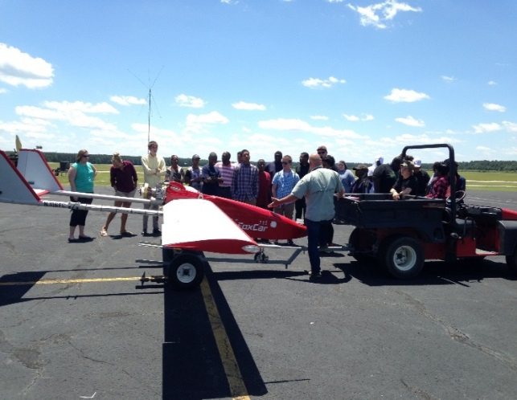
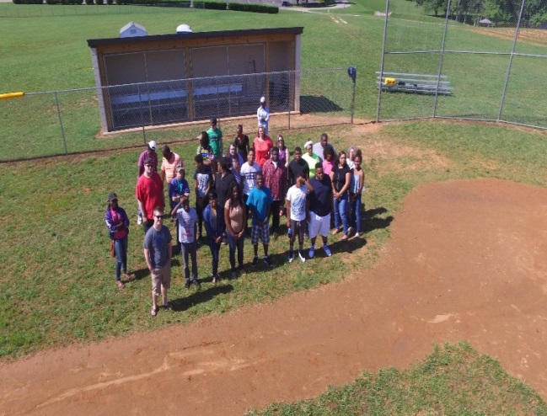
Robotic and Drone Academy
Academy was held at Southside Virginia Community College’s Daniel Campus in Keysville, Virginia
The Instructor was Vincent Brown, Robotics Instructor for SVCC
Twenty-two Youth Participated, 21 were WIOA Participants and 7 of those were co-enrolled in DARS
Built Robots
Learned to fly drones
Acquired the skill to take still and live pictures with drones
Studied about Career Opportunities Available in the Field of Robotics
Went on Field Trips to UAV Pro in Fort Pickett, Blackstone, VA and Dollar General Distributing in South Boston, VA
Raced their robots on a course for speed based on their independent design
Showed their still pictures and videos to their fellow classmates and a panel of judges to be graded on quality and stability.

Slide 22
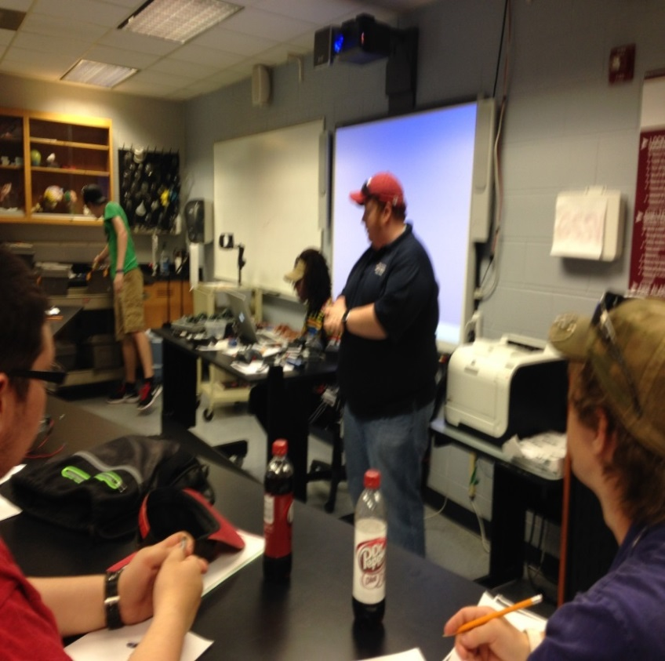
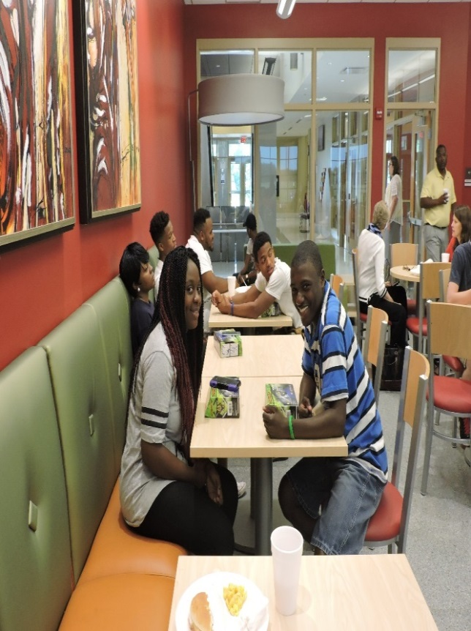
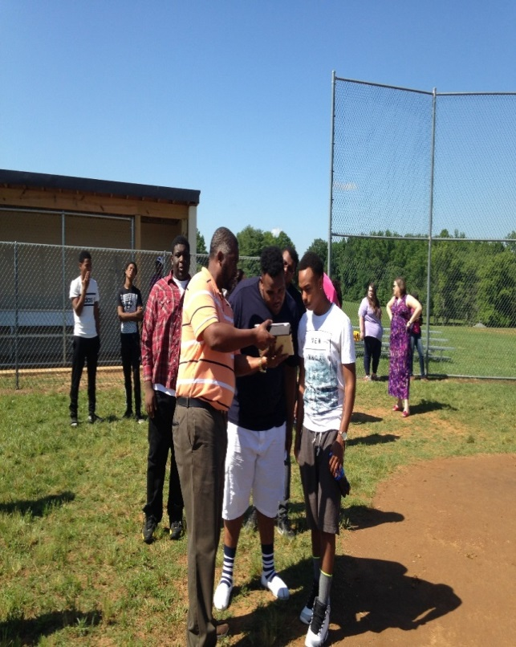

Slide 23
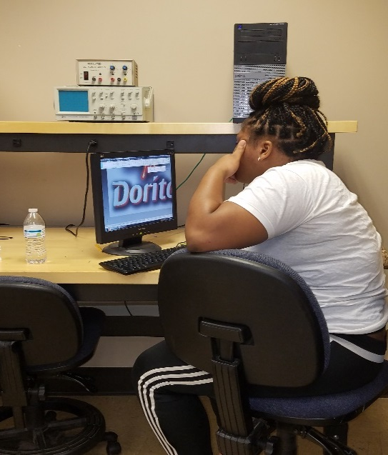
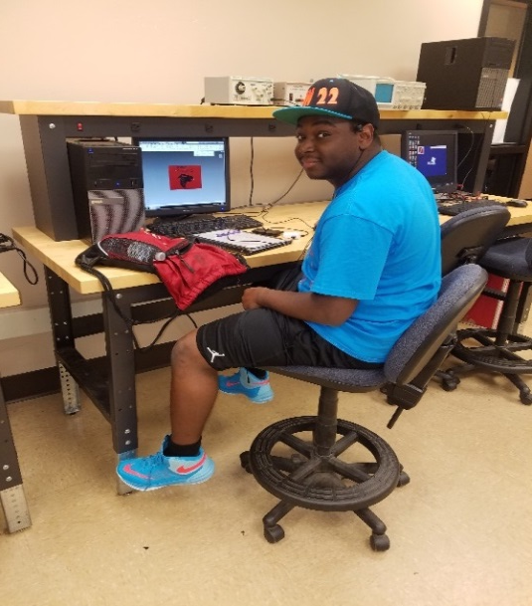
3-D Imaging Academy
Academy was held in the Lake Country Advanced Knowledge Center in South Hill, Virginia
The Instructor was Scott Edmonds, Instructor for SVCC
Ten WIOA Youth Participated in this Academy
Learned of Career Pathways and opportunities in 3-D Imaging
Learned how to use the software program AutoCAD which is used to design items to be printed with the 3-D printers
Created name tags, company logos, and trophies with AutoCAD and printed them on the 3-D printer and made a 2-D portfolio of their work
Went on a field trip to Cardinal Homes, Incorporated a Modular Home Manufacturer in Wylliesburg, Virginia and Dollar General Distributing in South Boston, Virginia.
Each participant made a portfolio of their original designs and presented it to their fellow classmates and to a group of judges. They were also given an oral test on their AutoCAD skills to demonstrate to the judges.

Slide 24
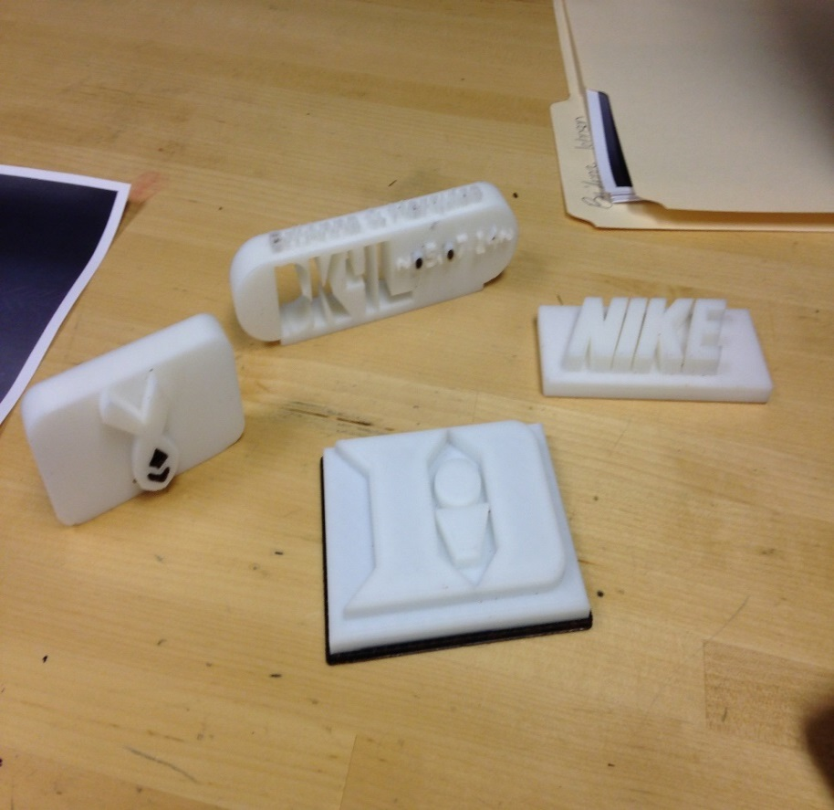
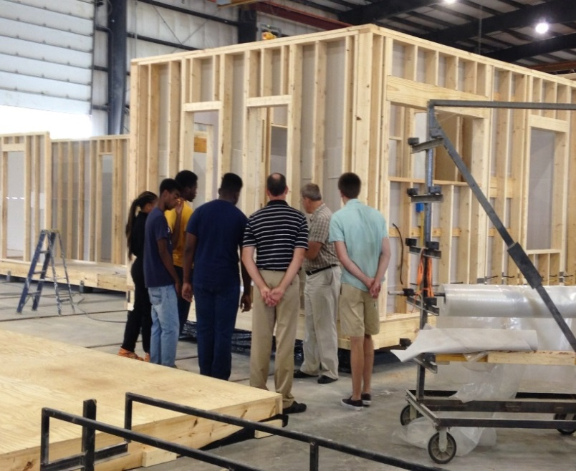
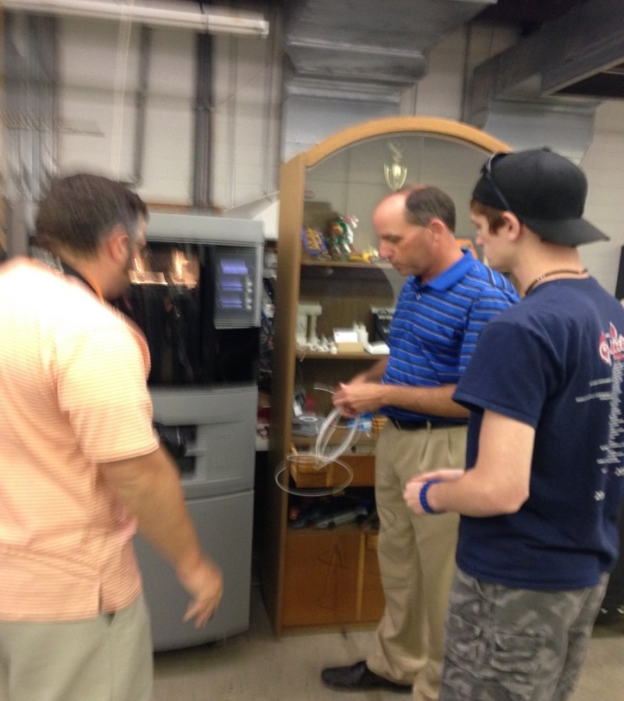
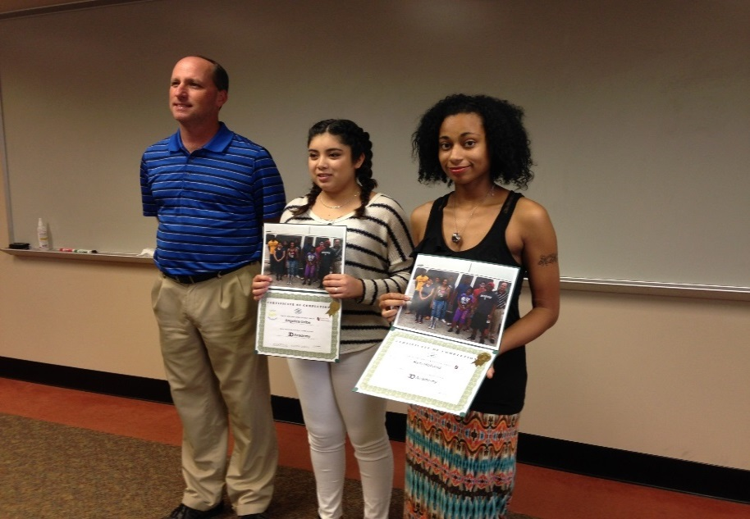
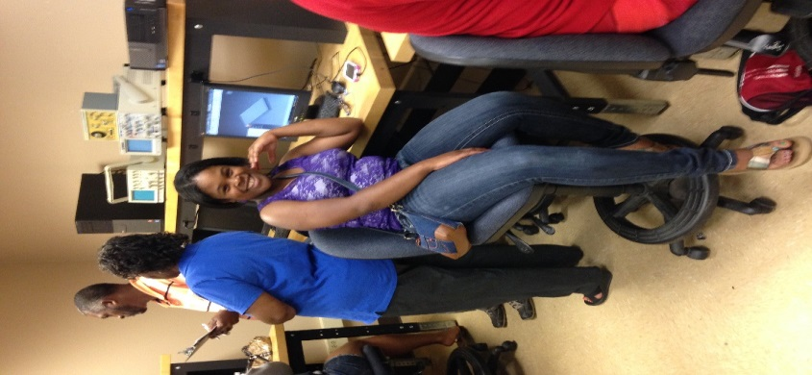

Slide 25
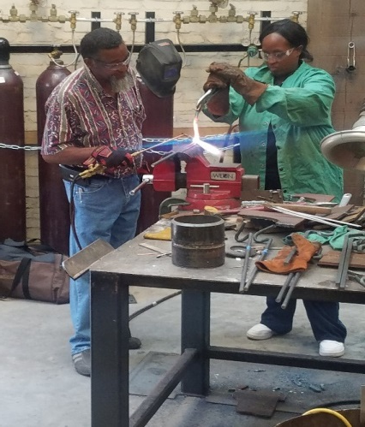
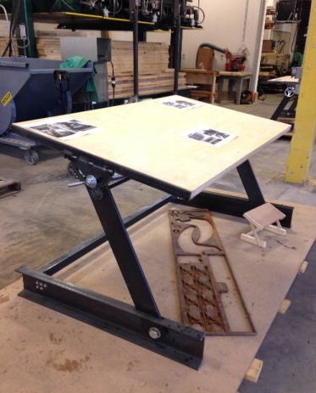
Welding Academy
Academy was held at the Southern Virginia Higher Education Center in South Boston, Virginia
The Instructor was Fernandez Bruce, Instructor for the SVHEC
Ten WIOA Youth Participated, three were co-enrolled in DARS
Learned of Career Pathways and training opportunities in Welding
Learned about different types of welding like MIG, TIG, and Stick
Worked in a team environment to create two drafting tables
Creatively worked independently to design fireplace pokers and shovels
Went on a field trip to Slap Nasty Designs in South Boston, Virginia and Dollar General Distributing also in South Boston, Virginia.
Gave presentations on what they learned in the academy and showed their pokers and shovels to be judged independently

Slide 26
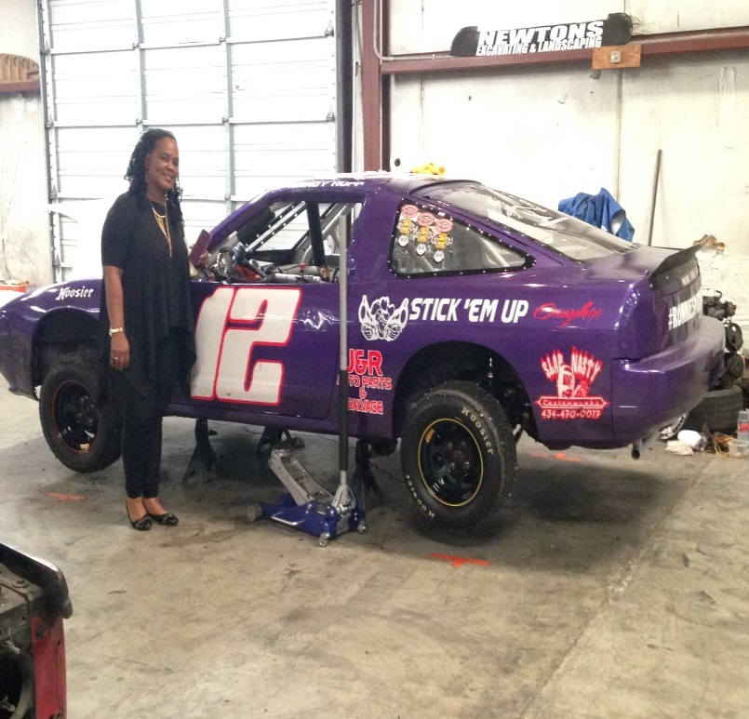
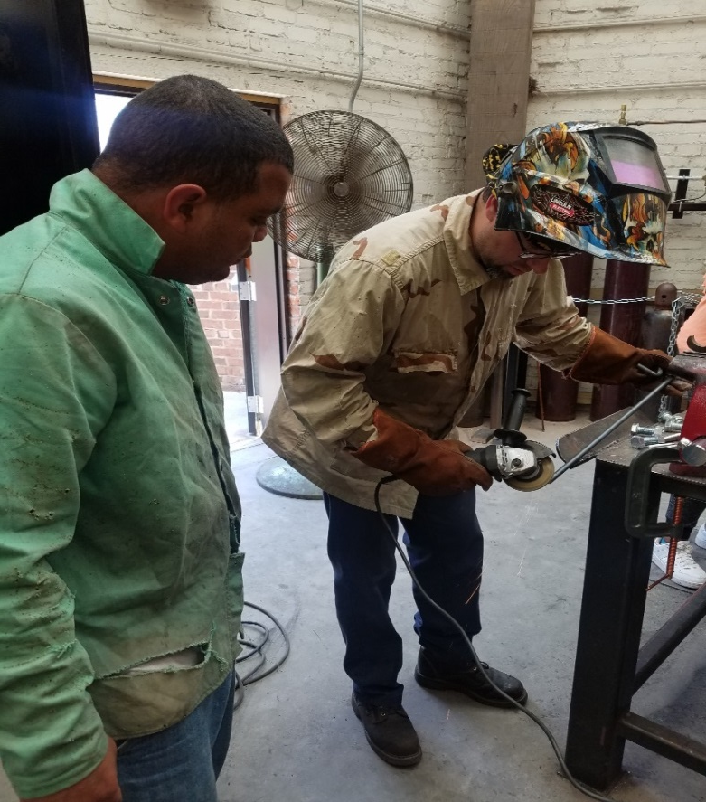
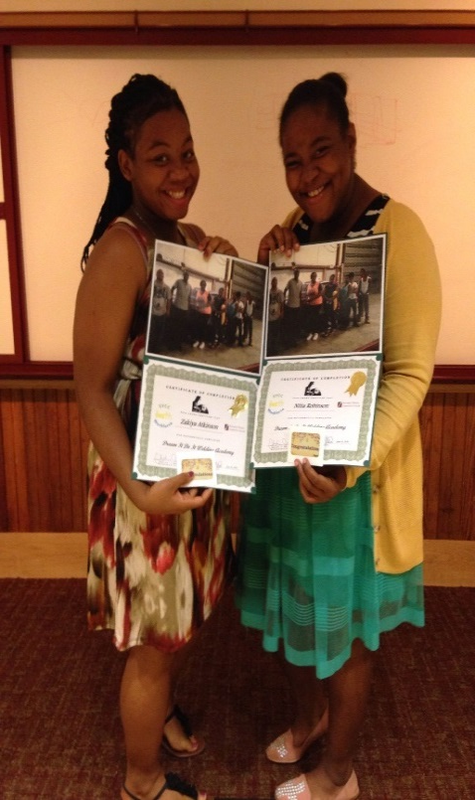
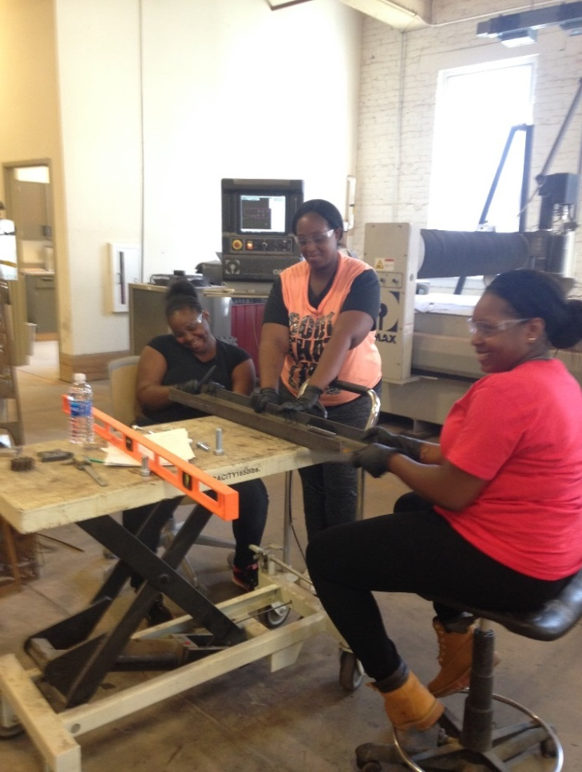
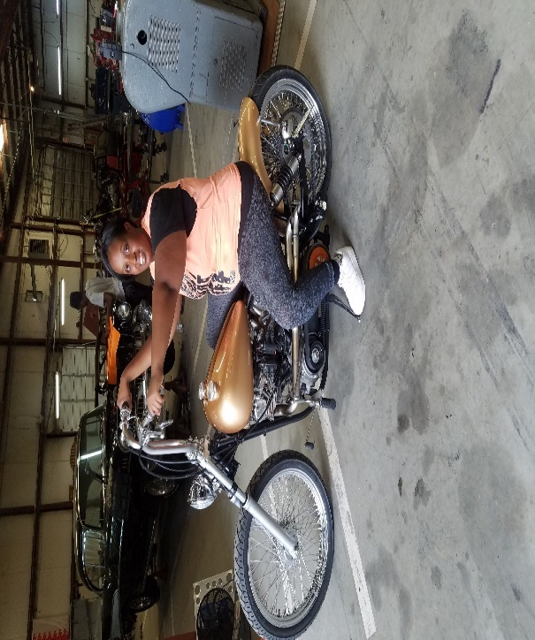

Slide 27
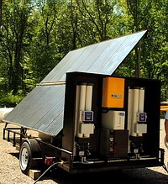
WWRC Training Opportunities
WWRC – Manufacturing Academy Pilot
MT1 and MSI Training
Nationally recognized credentials MT1, MS, OSHA 10 and CRC
Notes:
So not only did we have these 3 camps in southside we also had a camp at ‘Wilson Workfoce and Rehabilitation Center.
This was a residentil academy that was also a week long. This was soley an academy for IWD. They worked on purifying and bottling well water. Like the other camps - tours were included as well as a presentation at the end.
Whats exciting about this camp – it also lets the student consider additional training at WWRC.
This past august, WWRC started a Manufacturers Technician Training. This training is an 18 week class. At the end of this training students can potentially come away with 4 nationally recognized credentails
Career Readiness Certificate (Several manufacturers in VA require this for application)
OSHA 10
Manufacturing Specialist certificate
Manufacturing Technician 1 certificate
Purpose of the WWRC Manufacturing Academy
To create interest in the STEM field for PERT age students who have been assessed and found to have the ability and an interest in attending a ‘hands-on’ technical learning experience on the WWRC campus in the area of modern manufacturing
To enhance critical thinking skills as they relate to process flow development, team and group interaction
The enhance development of self-confidence through the positive learning aspects of the camp experience
To augment future enrollment needs of the MTT-MT1 training program by providing a pipeline of potential clients already introduced to many of the basic principles of manufacturing

Slide 28
Dream It. Do It.
Notes:
We have partnered with the Virginia Manufacturers Association to work closely with employers. This is where my position has come in as the CPID VMA Liaison. My office is located at their headquarters and I work directly with VMA members. This has been invaluable. Not only have I been able to meet employers but I’m learning about the credentials needed for manufacturing, issues that manufacturers face, and what they need in their employees. I am also working with VMA to develop a tool to assess Lean manufacturing, universal design and assistive Technology within a manufacturing plant. With this we are working to show Virginia manufacturers how accessibility and accommodations benefit business.
VMA though their Manufacturing Skills Institute has developed certifications that are state and nationally recognized. CPID is especially interested in their Manufacturing Skills Certificate and Manufacturing Technician 1 certificate.
I have also learned more about VMA’s Dream it. Do it. An outreach created by manufacturers to address the interest gap. This outreach involves week long camps that help youth explore advanced manufacturing. They have also developed the Dream It. Do it. Website that helps students explore careers and even includes a budget activity to show students how much they need to earn depending on the car/apartment/phone/social choices they make.

Slide 29
Flexibility of Choices for training and supports
Regional Summer Academies
Community College
Adult Education
Plugged In
Aztec Software
Various online opportunities
Notes:
One of the defining aspects of Career Pathways is the flexibility of training and supports available. This summer in Region 8 we will sponsor three Five Day Summer Academies in partnership with the Virginia Manufacturers Association Dream It Do It camps, the South Central Workforce Development Board and Virginia Southside Community College to introduce students to manufacturing. The three academies will focus on 3D Printing, Robotics and Welding. They will also participate in a tour of Drone factory.
Kate Kaegi will meet with the students beforehand for brief individualized vocational evaluation prior to the camp. This will give the students and instructors an idea of what supports are needed.
We are in the process of hiring an AT Specialist who will work to support CPID participants. We will also establish an AT loaner library so that participants can try out equipment and software before counselors commit to purchase.
If WILSON WRC is not the right setting for a consumer, multiple entry and exit points are an important part of Career Pathways. There are other entry points to the nationally recognized MSI Certifications including local community colleges and Workforce Centers. We are partnering with Adult Education and the Virginia Adult Learning Resource Center to offer academic supports to Career Pathways participants through Plugged In and other programs.

Slide 30
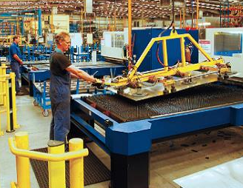
Critical Manufacturing “Mid-Skill” Occupations
Critical Mcturing “Mid-Skill” Occupations
Positions require certification regarding broad-based knowledge about multi-step processes to successfully trouble-shoot and solve problems beyond traditional “machine” operators:
Operator
Production Operator
Production Technician
Technician
Chemical Equipment Operator
Chemical Operator
Fixers
CNC Technician Manufacturing Technician
Production Manufacturing Specialist
New occupational description for operating precision machinery, systems and processes in modern manufacturing = Manufacturing Technician (MT)
Notes:
Sample MT1 Job Titles:
Operator
Production Operator
Production Technician
Technician,
Warehouse and ingredient worker
Maintenance worker
Manufacturing Technician
Production Manufacturing Specialist

Slide 31
Lessons learned
Referrals need work
IWD can flourish in an integrated setting
Disclosure can be an issue
Interest is out there
Academies have sparked new interest in career goals
Woman ROCK!
Need to increase awareness of opportunities for woman

Slide 32
Important Upcoming Opportunities
WWRC Manufacturing Technology Training (MTT) Program dates
March 27 Intake for CRC and OSHA training for May MTT
May 1 MTT program begins
July 31 Intake for CRC and OSHA Training August MTT
Aug. 21 MTT program begins
WWRC Manufacturing Academies – Residential
July 2-7 and Oct. 9-14
DBVI Academy - Residential
June 26-29 Robotics and IT with an emphasis on coding
Valley Vo-Tech – Day Camp
July 10-14 CNC/Machining Camp
Academy dates for Workforce Areas 2, 4, 8 and 11 coming soon!

Slide 33
Paula Martin
Assistive Technology Resources and Supports:

Slide 34
Stump the VR Professional
Questions???

